Slide 1
The Web Computer and Its Operating System: a New Approach For Creating Web Applications
Sergejs Kozlovičs
Institute of Mathematics and Computer Science, University of Latvia (Riga, Latvia)
ERDF project #1.1.1.2/16/I/001
Application #1.1.1.2/VIAA/1/16/214

Slide 2
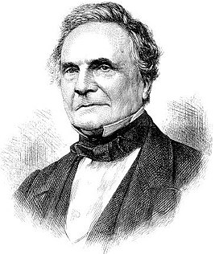
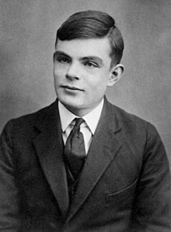
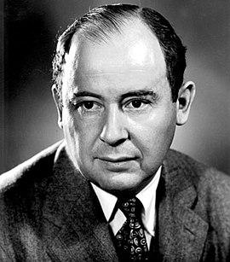

Slide 3
What Babbage, Turing, and von Neumann had in common?

Slide 4
The same mindset!
born in 1791
born in 1912
born in 1903

Slide 5
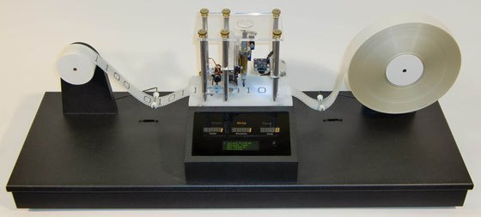
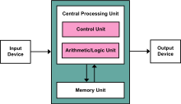
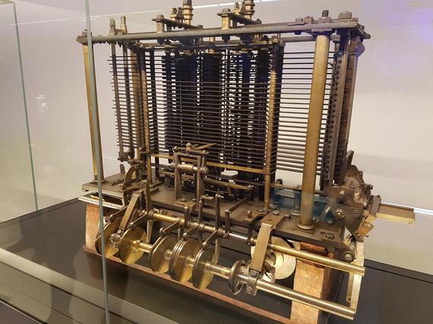
The 3-Singles Assumption
a single computer
operated by a single user
executing one program
at a time
Notes:
their inventions; this mindset is not bad; in my opinion, the technology has to adapt to the human brain, not vice versa

Slide 6
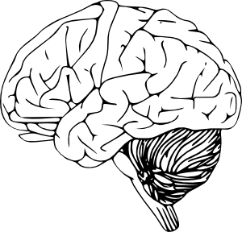
The 3-Singles Assumption
a single computer
operated by a single user
executing one program
at a time
Notes:
their inventions; this mindset is not bad; in my opinion, the technology has to adapt to the human brain, not vice versa

Slide 7
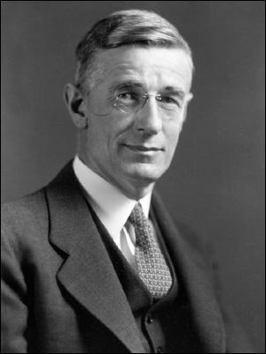

And Then the Web Comes...
Vannevar Bush, “As we may think”, 1945

Slide 8


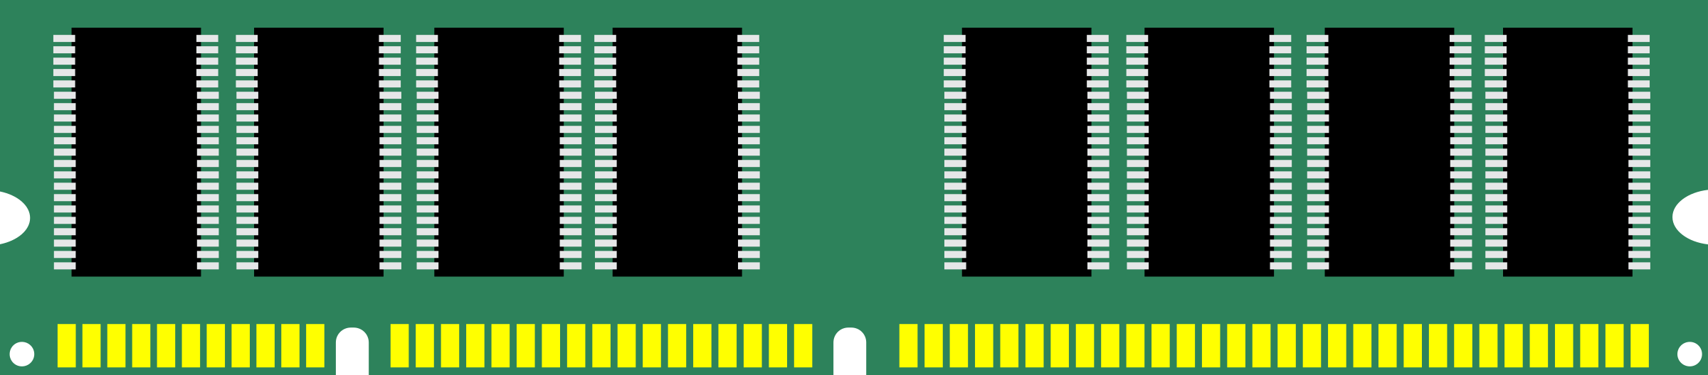
And Then the Web Comes...
Server
Server
vs.

Slide 9


And Then the Web Comes...
Server
vs.

Slide 10
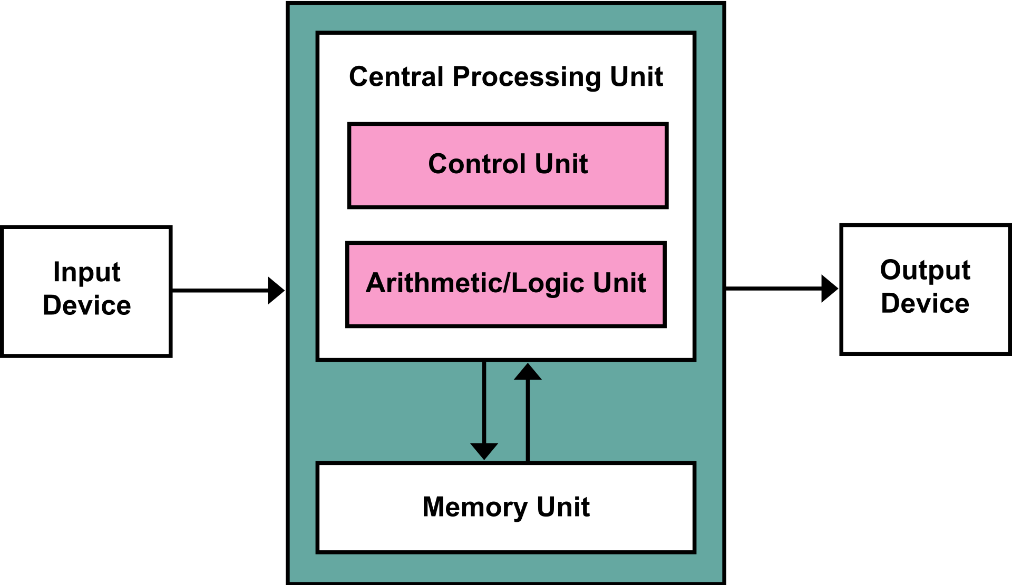
The Modern OS
can handle concurrent programs
can handle multiple users
Notes:
the OS can handle multiple programs and users competing for the CPU and memory; the technology takes steps towards our thinking

Slide 11
The Modern OS
can handle concurrent programs
can handle multiple users
Where is the network?

Slide 12
The Modern OS
can handle concurrent programs
can handle multiple users
Where is the network?
We still have to think about it!

Slide 13

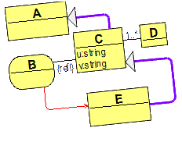
We want the 3-singles assumption when developing web applications
Think classicaly. Deploy webically.

Slide 14

The Web Computer
Notes:
I don’t want to sell you a product (now). I want to sell you and idea.

Slide 15
The Web Computer
an abstraction*
factors out the network
provides the illusion
of a single target computer
Notes:
an abstract concept, but with an implementation

Slide 16


The Web Computer
web memory
web processors
web I/O devices
Notes:
and the programmer works with these primitives as if they were attached to a single computer

Slide 17


web I/O devices
(server-side, client-side, cloud)

Slide 18
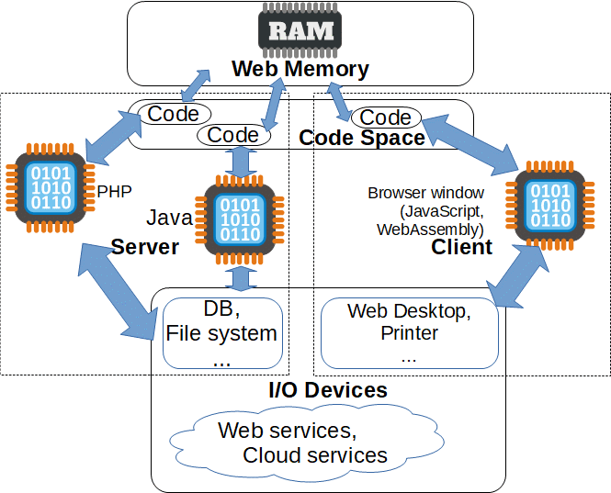
Notes:
Harvard-style: security considerations (we cannot trust the client in the web environment due to possible code injection attacks);
different environments for code (the server can execute PHP, Java, and Python code, while the client runs JavaScript and WebAssembly code);

Slide 19
data
code
Harvard-style
memory!
Notes:
Harvard-style: security considerations (we cannot trust the client in the web environment due to possible code injection attacks);
different environments for code (the server can execute PHP, Java, and Python code, while the client runs JavaScript and WebAssembly code);

Slide 20
Web Memory
in sync
between all
web procs
a graph (OOP-like)
memory, like in Java
(MOF/ECore-like model)
synchronized between
all web processors
(server-side and client-side)

Slide 21
The Code Space
existing
technologies
for code

Slide 22
The Code Space
Consists of actions:
name →entry point

Slide 23
The Code Space
Consists of actions:
name →entry point
uploadFile(JSON)=staticjava:org.webappos.
webcalls.FSActions_webcalls
#uploadFileToCurrentProject

Slide 24
The Code Space
uploadFile(JSON)=staticjava:org.webappos.
webcalls.FSActions_webcalls
#uploadFileToCurrentProject
the name can be used as a pointer to code
(can be stored in web memory)
the name is implementation-agnostic
(the caller is not aware of where the code will be executed)
Notes:
even client-side server-side web processor

Slide 25
The Code Space
uploadFile(JSON)=staticjava:org.webappos.
webcalls.FSActions_webcalls
#uploadFileToCurrentProject
the action code can be:
private (requiring an authenticated session) vs. public
non-static (requiring web memory) or static

Slide 26
The Code Space
uploadFile(JSON)=staticjava:org.webappos.
webcalls.FSActions_webcalls
#uploadFileToCurrentProject
calling conventions:
an object (pointer) in web memory → result in web memory (or void)
JSON → JSON (non-static actions can access web memory)

Slide 27
The Code Space
uploadFile(JSON)=staticjava:org.webappos.
webcalls.FSActions_webcalls
#uploadFileToCurrentProject
web calls of this action can be invoked at any side;
each actions must be validated for not harming the server

Slide 28
The Code Space
uploadFile(JSON)=staticjava:org.webappos.
webcalls.FSActions_webcalls
#uploadFileToCurrentProject
the name of the instruction set
(e.g., staticjava, lua, clientjs, shell_script, python3, etc.)

Slide 29
The Code Space
Analogy with classical instruction sets:
x86
IA-64
Java bytecode
...
uploadFile(JSON)=staticjava:org.webappos.
webcalls.FSActions_webcalls
#uploadFileToCurrentProject
the name of the instruction set
(e.g., staticjava, lua, clientjs, shell_script, python3, etc.)

Slide 30
Web Processors
Each supports 1 or more instruction sets
Hierarchy:
JS
JS 6
Client-side JS 6
Any-side JS 6

Slide 31

Web Processors
remote
(specific
OS/environment,
e.g. Solaris)
mainly JavaScript;
possible WebAssembly, Flash,
Java applets...
PHP, Java, Python...

Slide 32
Web I/O Devices
Standardized via APIs:
File Systems
  Server-side file system (the cloud for storing
  user home directories)
  Remote cloud drives (iCloud drive, OneDrive,
  Google drive..)
Desktop
Registry (Tree-like database)

Slide 33
Web I/O Devices
Non-standardized devices can be accessed via actions implemented using native code (in actions):
Browser-side printer (accessible from client-side JS)
Specific server-side or remote database (accessible from server-side Java/C++/Python code)
Specific server-side device (e.g., an NVIDIA card accessible via CUDA)
...

Slide 34
The Web Computer: Summary
web memory
code space (actions)
web I/O devices
Developers do not access them directly.
Accessible via APIs.
Who provides the APIs?

Slide 35

The Web Computer OS

Slide 36
webAppOS/formal
defines APIs
  for web app developers
    for accessing web memory
    for accessing web I/O devices and services
    for launching code
  for web I/O device drivers
  for other internal components
defines how to deploy web applications and web services
defines how apps communicate with the end user
manages authentication and access to third-party scopes
(e.g., Google services)

Slide 37
webAppOS Applications and Services

Slide 38
webAppOS applications
A webAppOS application consists of:
a set of web calls actions (from the code space)

Slide 39
webAppOS applications
A webAppOS application consists of:
a set of web calls actions (from the code space)
can be factored out into libraries
(~DLLs/shared libraries)

Slide 40
webAppOS applications
A webAppOS application consists of:
a set of web calls actions (from the code space)
artefacts for delivering a web app to the end user

Slide 41
webAppOS applications
A webAppOS application consists of:
a set of web calls actions (from the code space)
artefacts for delivering a web app to the end user
GUI, console, and their variations

Slide 42
Delivering Applications
Classical applications
webAppOS applications
native GUI executable
native console executable
Java bytecode
(GUI or console)
shell script (console)
...
different
webAppOS
adapters
html/css/js (GUI)
PHP (GUI)
javaservlet (GUI or console)
web sockets (console)
.war (GUI or console)
...

Slide 43
webAppOS services
A webAppOS service is a module that provides useful functionality to applications but is invisible to end users.

Slide 44
Services
Types
RESTful services:
  via javaservlet
  via PHP
  via HTML
  via .war
non-HTTP (e.g., mail) service
via web sockets
...
different
webAppOS
adapters

Slide 45
Implementation

Slide 46
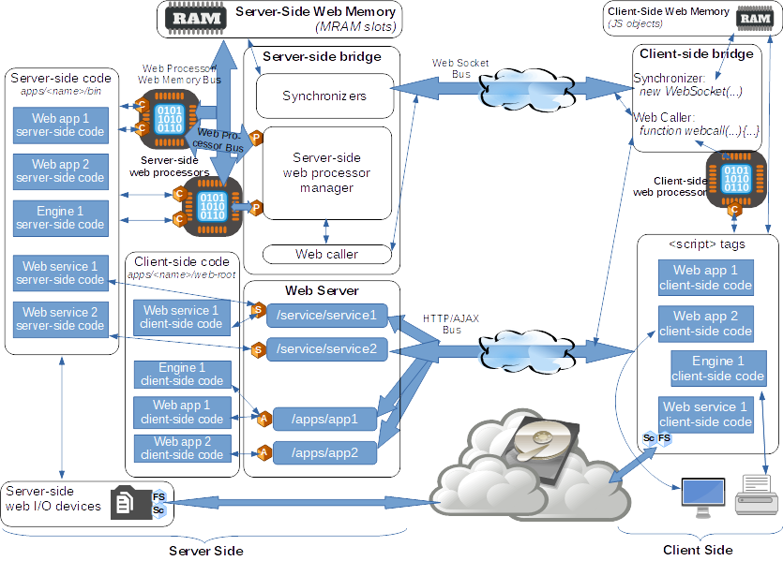

Slide 47
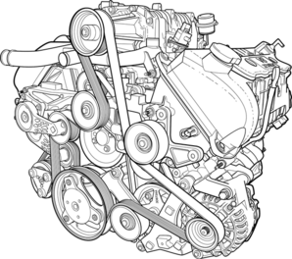

To be able to drive a car,
you don’t need to know how the engine is built

Slide 48
Primary Languages
Server-side: Java → other languages
  no stack overflow problems
  no char* overflow problems
  multiplatform
Client-side: JavaScript → client-side technologies
+ web calls are possible from any side

Slide 49
Web Socket Bus

Slide 50
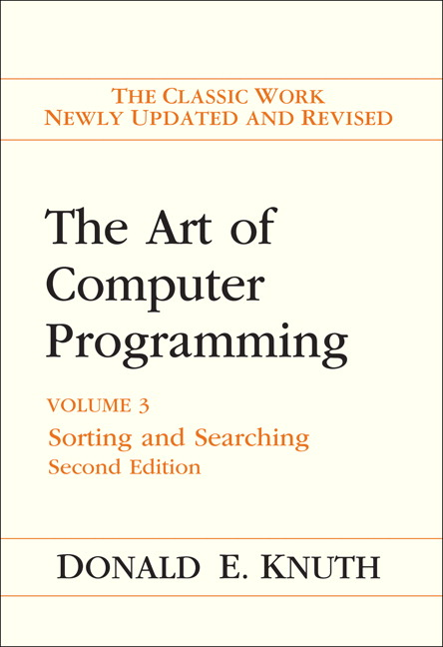
Implementing Web Memory at the Server Side
Original repository AR
  encoding resembles Kolmogorov complexity
  encoding suitable for direct synchronization via the network
Implemented via OS-managed memory-mapped files using advanced hash tables (10,000+ memory slots per
single server)
Users can re-connect to the same web memory slot

Slide 51
Web processors
and
web calls
adapters

Slide 52
Web Processor
↔
Web Memory
Bus

Slide 53
HTTP/AJAX
Bus
Transferring
HTML/JS/CSS;
providing
URLs
for apps and
services.

Slide 54
Bridges
Seamless
mediators
between the
network
and the nodes.

Slide 55
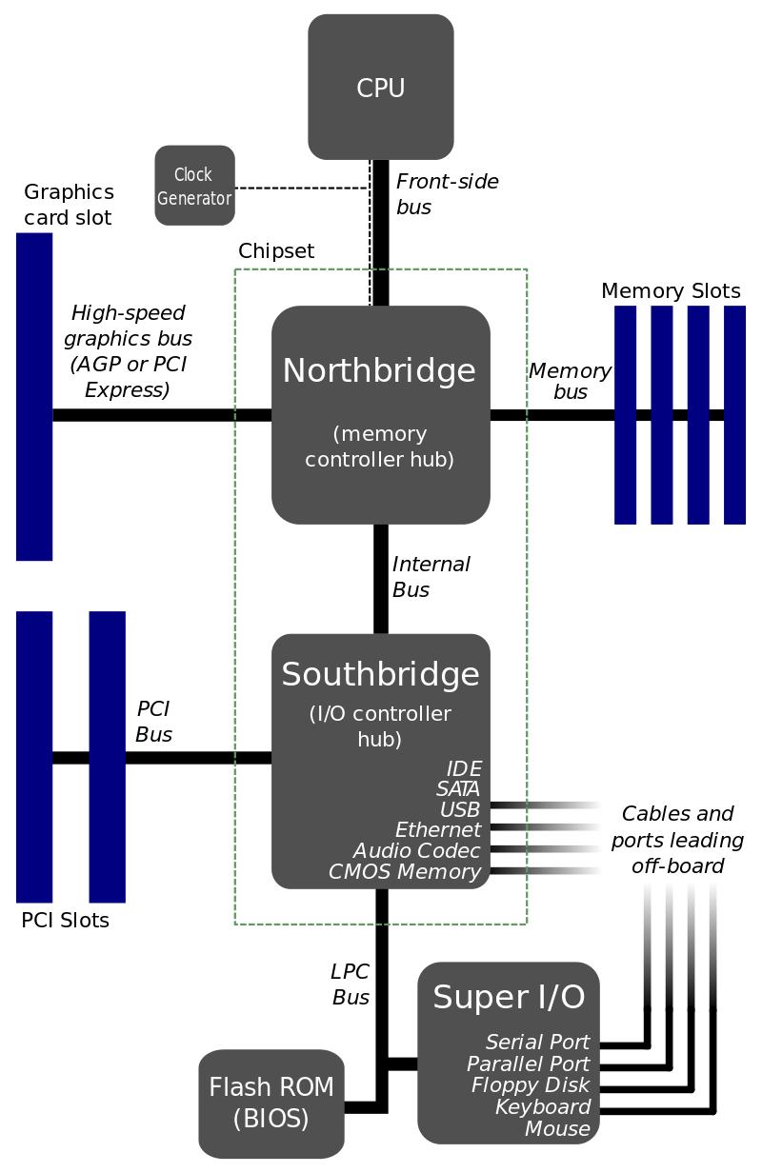
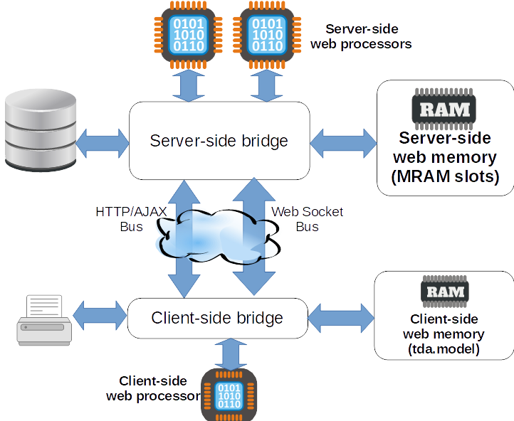
Bridges

Slide 56
Benefits (1)
The single computer illusion:
automatically and transparently synchronized web memory (a shared data model between the client and the server)
implementation-agnostic web calls
(the location if the code is not important)

Slide 57
Benefits (2)
Ecosystem + documentation:
APIs for accessing the resources of the web computer
(web memory, web processors, web I/O devices)
APIs for third-party drivers
support for third-party services
(scopes & auth mechanism)
standardized adapters for different types of applications and services
support for libraries (DLL analogs)

Slide 58
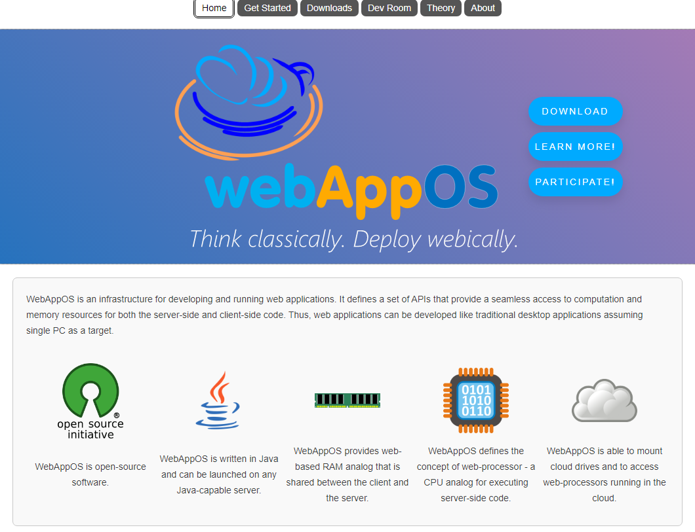
Benefits (3)
Open-source:
http://webappos.org
GitHub link
Specification
API & Docs

Slide 59
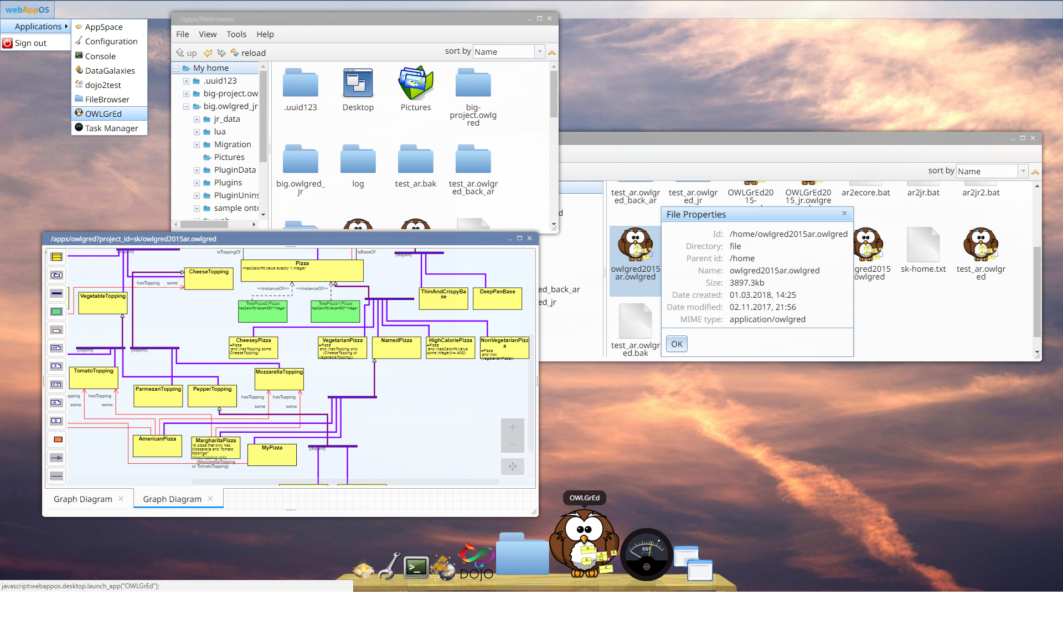
https://youtu.be/Oycer61_SYw

Slide 60
https://youtu.be/Oycer61_SYw

Slide 61

A Guinea Pig: OWLGrEd
OWLGrEd
(Graphical Ontology Editor)
http://owlgred.lumii.lv
Web app

Slide 62


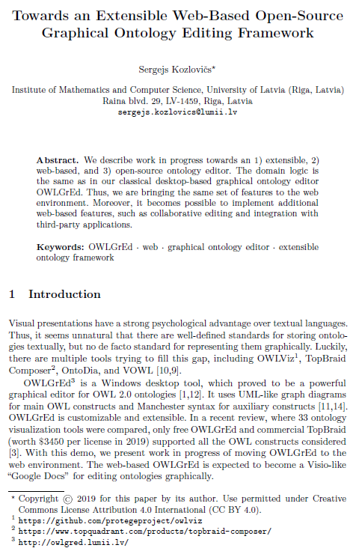

Slide 64
“You want it [the browser] to be a
mini-operating system, and the people who
did the browser mistook it as an application.”
Alan Kay

Slide 65
“You want it [the browser] to be a
mini-operating system, and the people who
did the browser mistook it as an application.”
Alan Kay

Slide 66
Thank you!

