Slide 1
Efficient Model Repository for Web Applications Sergejs Kozlovičs Institute of Mathematics and Computer Science, University of Latvia (Riga, Latvia)
ERDF project #1.1.1.2/16/I/001
Application #1.1.1.2/VIAA/1/16/214

Slide 2
Model Repository (Model Storage)
Differences from databases:
tailored for storing models used by model transformations
usually in-memory
support only simple queries (graph traversal)
both read- and write- efficient (MongoDB write ops are 10x slower than read ops)

Slide 3
Models and Transformations
MOF-like models (CMOF, EMOF, ECore...) MOF=Meta-Object Facility (OMG standard)
model-transformations
transformation languages: MOLA, Epsilon, ATL, VIATRA...
classical languages: Java, C++, Python...
More at: http://webappos.org/theory/models

Slide 4
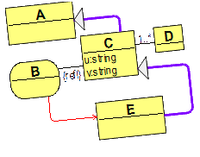
The Big Problem
Desktop model-based app
Web app

Slide 5
The Big Problem
OWLGrEd
(Ontology Editor)
http://owlgred.lumii.lv
Web app

Slide 6
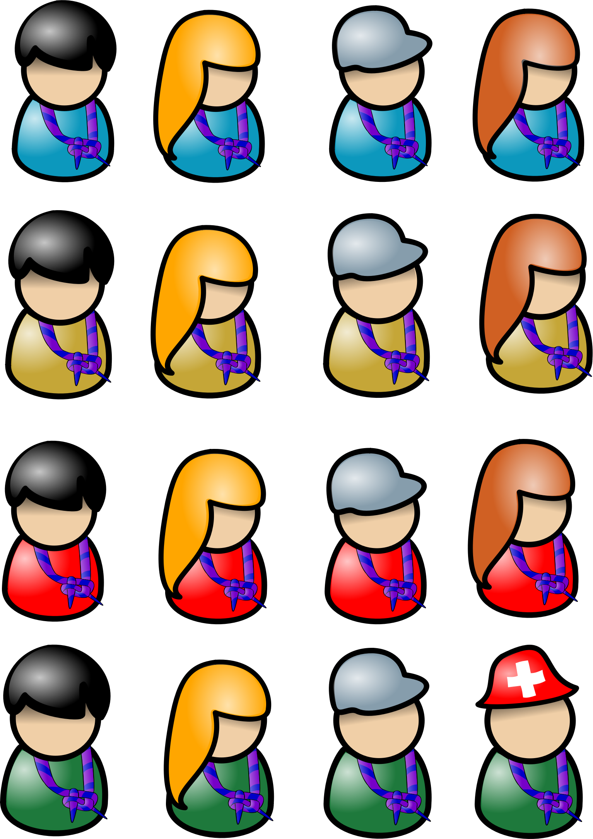
Issue 1: Server resources
Server
vs.

Slide 7
Issue 2: Synchronization
Server
delay, overhead, serialization

Slide 8
Dilemma: Existing Model Repositories
Memory-efficient, but not CPU-efficient (ECore)
CPU-efficient, but not memory-efficient (JR)

Slide 9
We propose “AR” (Actions Repository) http://webappos.org/dev/ar
Both CPU- and memory-efficient!

Slide 10
API

Slide 11
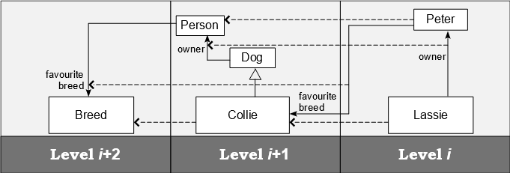
Multiple Meta-Levels

Slide 12
Šostaks’ conjecture
It is difficult for a human to think at more than two meta-levels at a time.
Still, it is fairly easy for a human to focus on any two adjacent meta-levels.

Slide 13
Šostaks’ conjecture
It is difficult for a human to think at more than two meta-levels at a time.
Still, it is fairly easy for a human to focus on any two adjacent meta-levels.

Slide 14
Šostaks’ conjecture
It is difficult for a human to think at more than two meta-levels at a time.
Still, it is fairly easy for a human to focus on any two adjacent meta-levels.

Slide 15
Existing APIs
Epsilon Model Connectivity Layer
ATL Model Handler Abstraction Layer
Shortcomings:
hard to use with mixed meta-levels
not efficient (e.g., when passing parameters)
concealed internal data structures

Slide 16
RAAPI (Repository Access API) webappos.org/dev/raapi

Slide 17
RAAPI Basics
Borrowed from the Transformation-Driven Architecture
Šostaks’ conjecture ready
operates on 2 adjacent meta-levels: Objects Level and Classes Level
64-bit references can be mixed between meta-levels

Slide 18
RAAPI Is Simple (Low-Level API)
Modificating actions:
createClass
createGeneralization
createObject
createAttribute
setAttributeValue
createAssociation
createLink
...

Slide 19
RAAPI Is Simple (Low-Level API)
Read-only actions:
findClass
findAttribute
isDirectSubClass
isDerivedClass
linkExists
getIteratorForDirectClassObjects
getIteratorForDirectSuperClasses
getIteratorForLinkedObjects
getIteratorForObjectsByAttributeValue
...

Slide 20
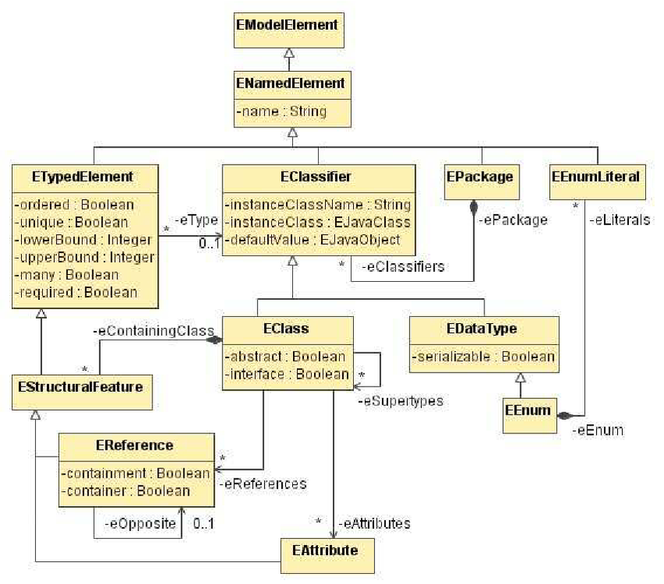
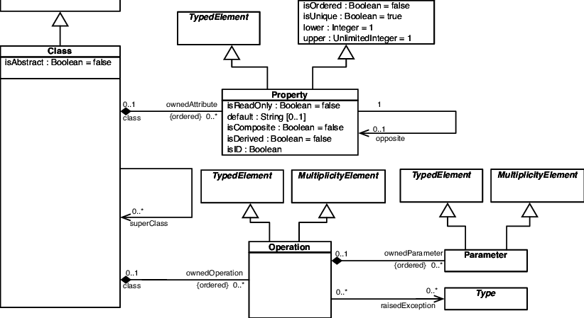
RAAPI is Meta-Metamodel Agnostic
ECore
EMOF

Slide 21
Encoding

Slide 22
RAAPI
Modificating actions:
createClass
createGeneralization
createObject
createAttribute
setAttributeValue
createAssociation
createLink
...

Slide 23
RAAPI
Repository =
a sequence of
RAAPI modificating actions
Modificating actions:
createClass
createGeneralization
createObject
createAttribute
setAttributeValue
createAssociation
createLink
...
[
createClass(“MyClass”, C1),
createAttribute(C1, A1, “name”),
createObject(C1, O1),
setAttributeValue(O1, A1, “John”)
...
]
=

Slide 24
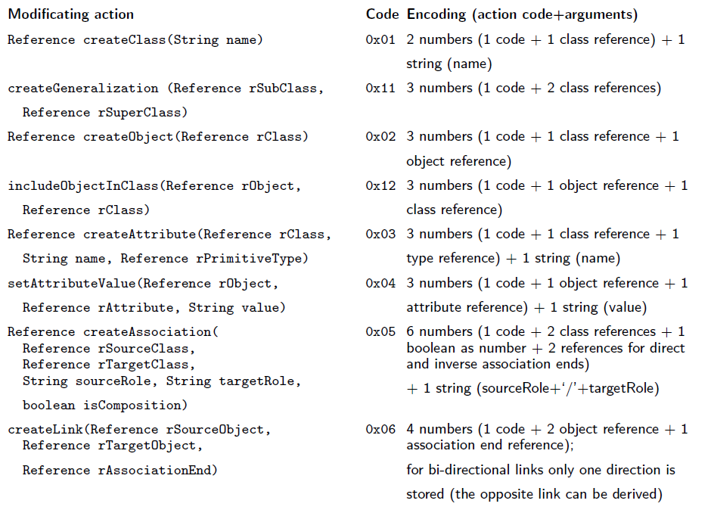

Slide 25
Repository “Assembler”
0x01, 1, “Person” // create Class Person (ref=1)
0x02, 1, 2 // create Person instance (ref=2)
0x03, 1, 3, “name” // create attribute “name” (ref=3)
0x04, 2, 3, “John” // set attribute value “John”

Slide 26
Repository “Assembler”
0x01, 1, “Person” // create Class Person (ref=1)
0x02, 1, 2 // create Person instance (ref=2)
0x03, 1, 3, “name” // create attribute “name” (ref=3)
0x04, 2, 3, “John” // set attribute value “John”
actions array
(IEEE doubles)
as in JavaScript
strings array
(UTF-8)

Slide 27
Encoding
actions (double[]):
[0x01, 1, 0x02, 1, 2, 0x03, 1, 3, 0x04, 2, 3]
strings:
[“Person”, “name”, “John”]
* colors and arrows are not stored!
non-string action

Slide 28
Implementation
Dynamic arrays (classical algorithms)
Only create-actions stored
(~Kolmogorov complexity)

Slide 29
Delete-actions?
We do not need to store them!
e.g., deleteAttributeValue (2, 3)
[0x01, 1, 0x02, 1, 2, 0x03, 1, 3, 0x04, 2, 3, 0x01...]
[“Person”, “name”, “John”, “xyz”, ...]
createAttributeValue

Slide 30
Delete-actions?
[0x01, 1, 0x02, 1, 2, 0x03, 1, 3, Λ, Λ, Λ, 0x01...]
[“Person”, “name”, Λ, “xyz”, ...]
No need for immediate array shifts

Slide 31
Re-arrange (shifting)
Performed when expanding/shrinking
dynamic arrays
[0x01, 1, 0x02, 1, 2, 0x03, 1, 3, Λ, Λ, Λ, 0x01...]
[“Person”, “name”, Λ, “xyz”, ...]

Slide 32
Re-arrange
Performed when expanding/shrinking
dynamic arrays
[0x01, 1, 0x02, 1, 2, 0x03, 1, 3, 0x01...]
[“Person”, “name”, “xyz”, ...]

Slide 33
Model Synchronization

Slide 34
Model Synchronization
Initial sync:
just send the actions and strings arrays
no need to convert the encoding!
Later syncs:
sync deltas in the same encoding (also delete-actions)

Slide 35
Model Synchronization
Using asynchronous web sockets:
very fast bi-directional channels (can send both binary and string data)
no need to wait for sync
No reference collisions: the server assigns even references, the client assigns odd

Slide 36
How to implement all RAAPI operations efficiently?

Slide 37
We have: the actions and strings arrays

Slide 38
Just 3 Additional Maps! (linear space!)

Slide 39
Just 3 Additional Maps (1)
action2string
[0x01, 1, 0x02, 1, 2, 0x03, 1, 3, 0x04, 2, 3]
[“Person”, “name”, “John”]
non-string action

Slide 40
Just 3 Additional Maps (2)
string2actions – inverse multimap
[0x01, 1, 0x02, 1, 2, 0x03, 1, 3, 0x04, 2, 3, ...]
“Person”
“name”
“John”
non-string action

Slide 41
Just 3 Additional Maps (3)
reference2actions - multimap
[0x01, 1, 0x02, 1, 2, 0x03, 1, 3, 0x04, 2, 3, ...]
1
2
3
non-string action

Slide 42
linkExists(obj ref A, obj ref B, assoc ref)
3 lists:
reference2actions[obj ref A]
reference2actions[obj ref B]
reference2actions[assoc ref]
The lists of indices turn out to be sorted!!!
Thus, we can use the «merge» approach + binary search to find the common action.
[0x01, 1, 0x02, 1, 2, 0x03, 1, 3, 0x04, 2, 3, .... 0x06, 1, 3, 2, ... ]

Slide 43
Binary search with deleted elements
Search on partially filled array
linear on classical computers
sub-linear on quantum computers
(Grover’s algorithm)
Use binary search as much as possible
Switch to linear search, when deleted elements are encountered
60.56% boost compared to just linear search

Slide 44
Cascade Delete
deleting CreateClass(reference)action:
[0x01, 1, 0x02, 1, 2, 0x03, 1, 3, 0x04, 2, 3, ...]
reference2actions(reference)
For each class object: reference2actions(object_reference)
createObject

Slide 45
AR is an in-memory repository. How to provide enough memory for multiple connected users?
Server

Slide 46
Memory-Mapped Files! (Memory that is efficiently swapped by the OS)

Slide 47
Memory-Mapped Files
memory-mapped file = array
we need to implement our 3 maps as arrays

Slide 48
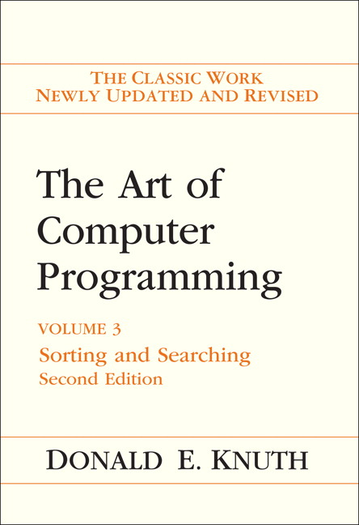
Memory-Mapped Files
Hash tables implemented on arrays
Modifications for multi-maps (just 2.28 collisions in average!)
Avoid hash value 0 for empty strings (2.85 times faster!)

Slide 49
Results: CPU
Real OWLGrEd model transformation using a model repository
(time in ms, 10% accuracy)
ECore | JR | AR (Java hash maps) | AR (hash tables) | AR (memory-mapped files)
1016 +big overhead | 857 | 423 | 618 | 760
* more detail in the paper

Slide 50
Results: Memory
JR | ECore | AR (Java hash maps) | AR (hash tables) | AR (memory-mapped files) 12.2 MB on disk
33.4 MB | 9.5 MB | 13.6 MB | 10.72 MB | 0.013 MB
max 1 | max 173 | max 111 | max 142 | 10 000+
1047 ms | 849 ms | 153 ms | 63 ms | 9-61 ms
* more detail in the paper

Slide 51
Results: Memory
JR | ECore | AR (Java hash maps) | AR (hash tables) | AR (memory-mapped files) 12.2 MB on disk
33.4 MB | 9.5 MB | 13.6 MB | 10.72 MB | 0.013 MB
max 1 | max 173 | max 111 | max 142 | 10 000+
1047 ms | 849 ms | 153 ms | 63 ms | 9-61 ms
* more detail in the paper

Slide 52
AR will be the default data format for web-based OWLGrEd
AR will be used as a memory analog in webAppOS - a model-based infrastructure for web applications; http://webappos.org

Slide 53
Thank you!

Slide 54
Specs
More than 200 000 000 actions (10 GB per repository)
The actions and strings arrays can grow independently up to 1,310,720,000 and 131,072,000, respectively

Slide 55
